Slide 1
PL-600 Power Apps Architecture

Slide 2
Agenda
Discuss options for apps and how to choose where to start
Discuss app composition options
Using components as part of your app architecture
Considerations for including Portals as an app in your architecture

Slide 3

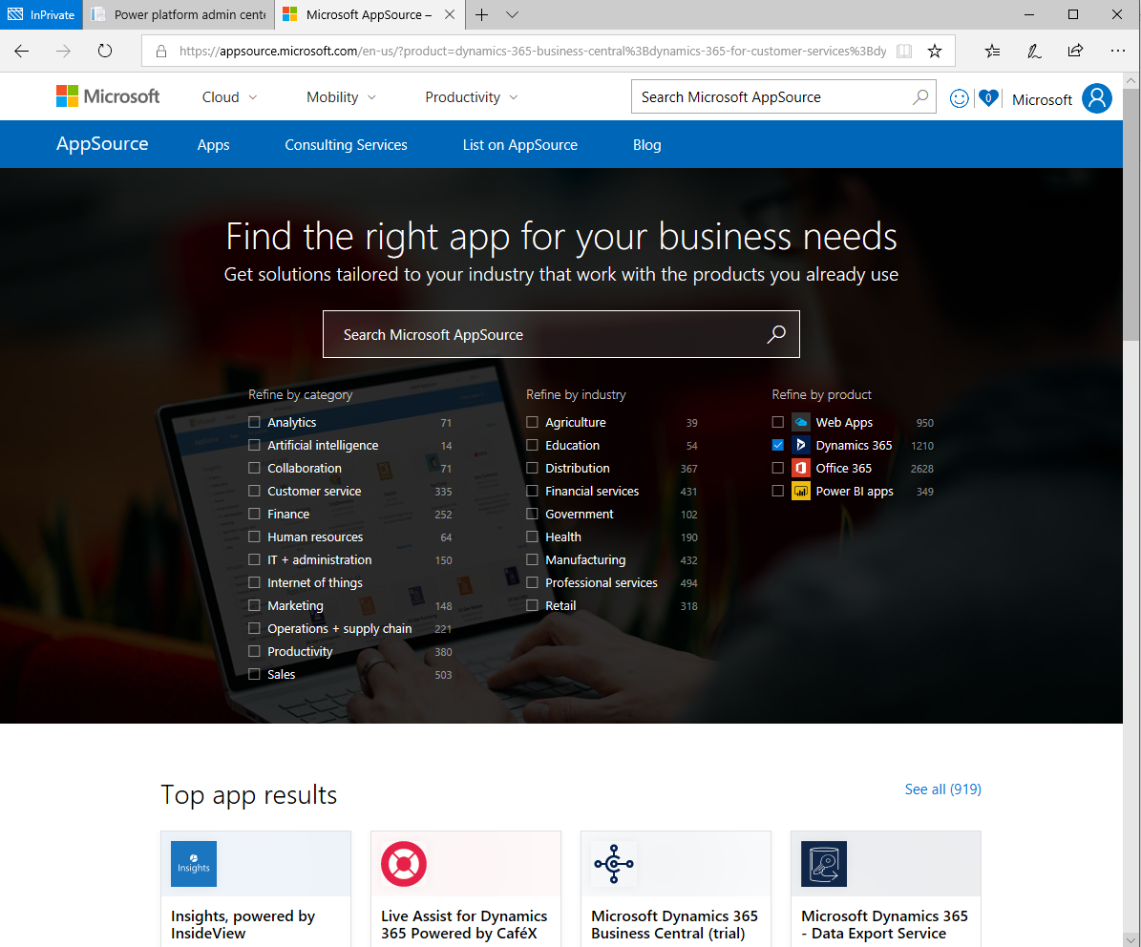
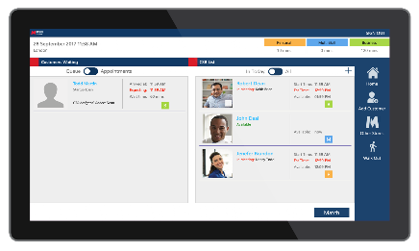
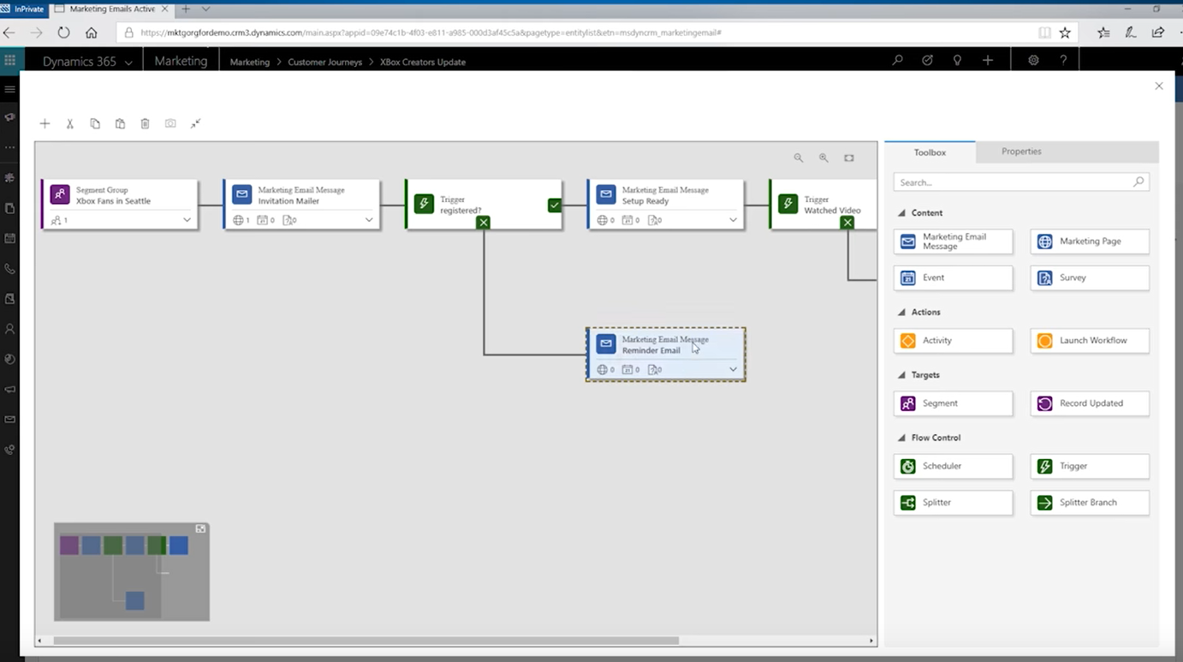
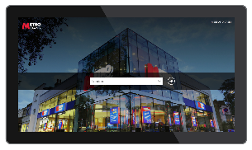
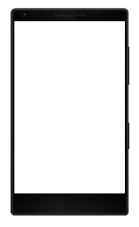
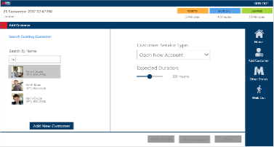
Options for apps
Start with Dynamics 365
AppSource
Custom
Notes:
There are different options to provide your business with apps. Dynamics 365 apps are enterprise ready, yet configurable applications that can perform a number of workloads such as sales, customer service, marketing, HR, retail, etc. Many of these apps evolved from Dynamics CRM. These are known as 1st party apps.
For specific industries and vertical, there might be an available 3rd party apps available in app source.
Finally, for unique workloads or where there are specialized business functions, organizations can harness the Microsoft Power Platform and build custom applications.

Slide 4
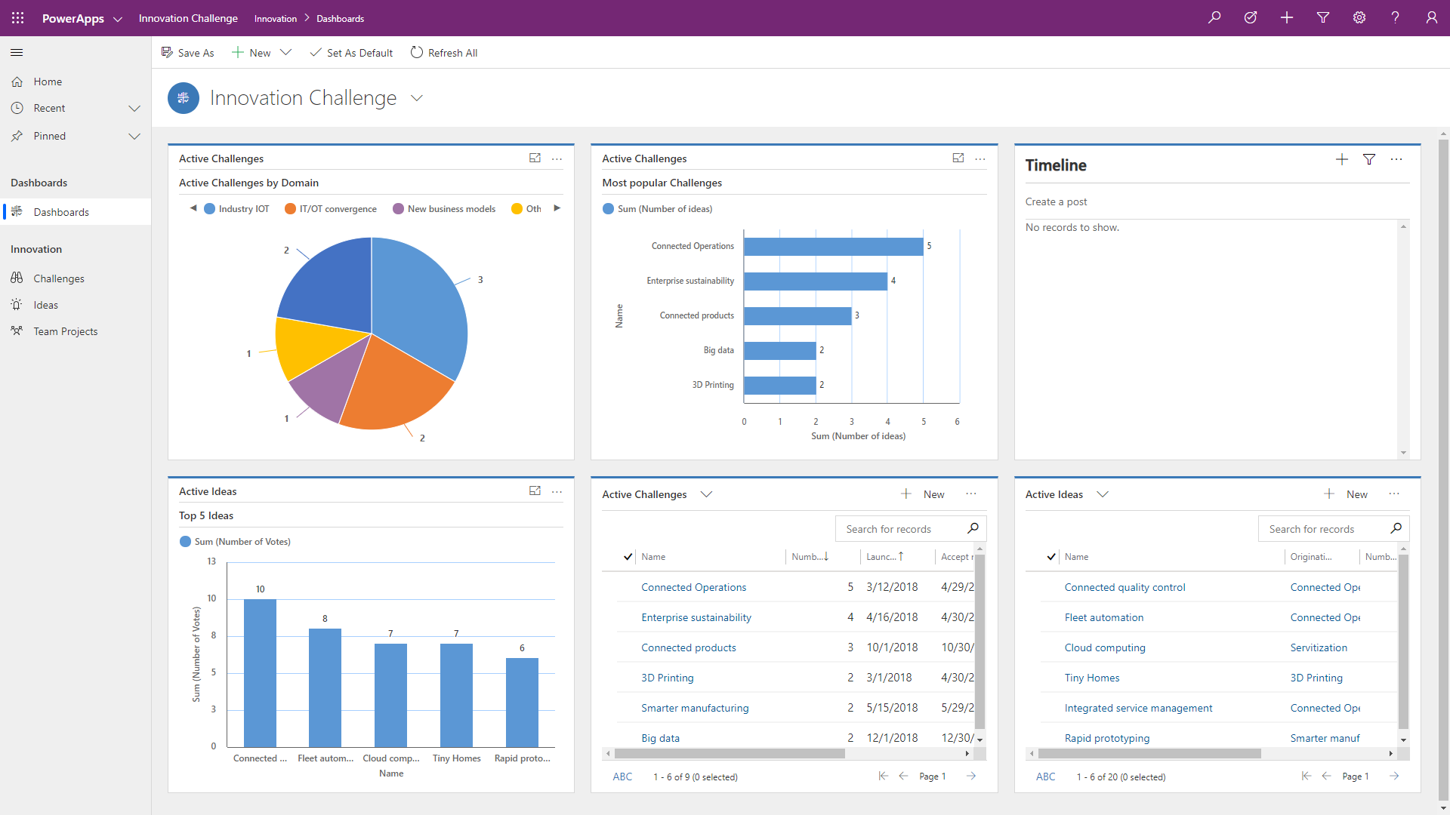
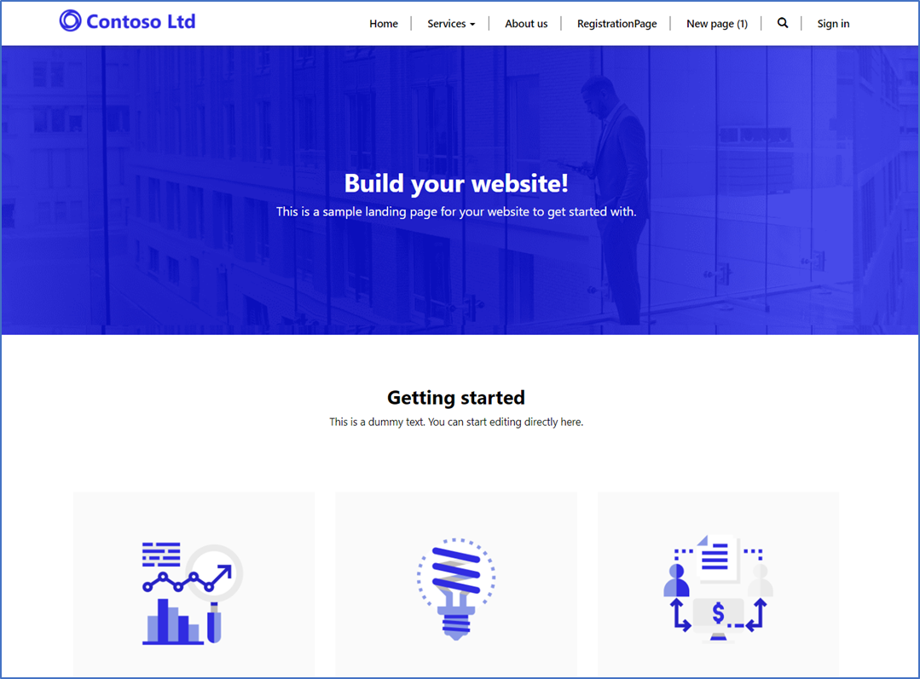
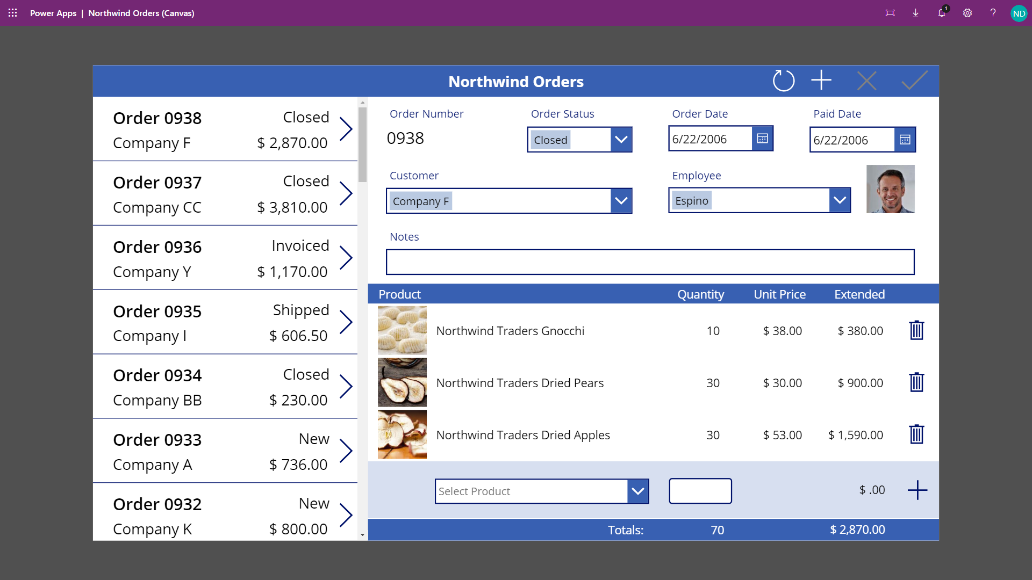
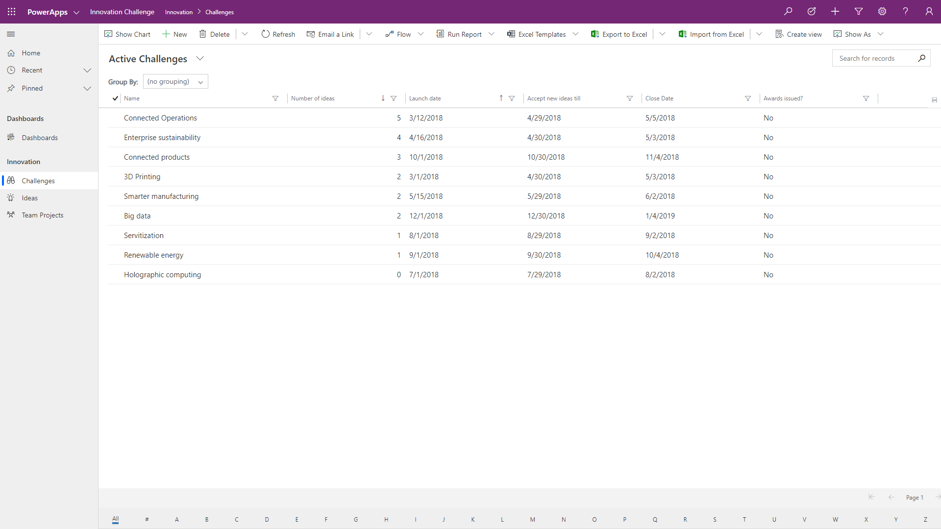
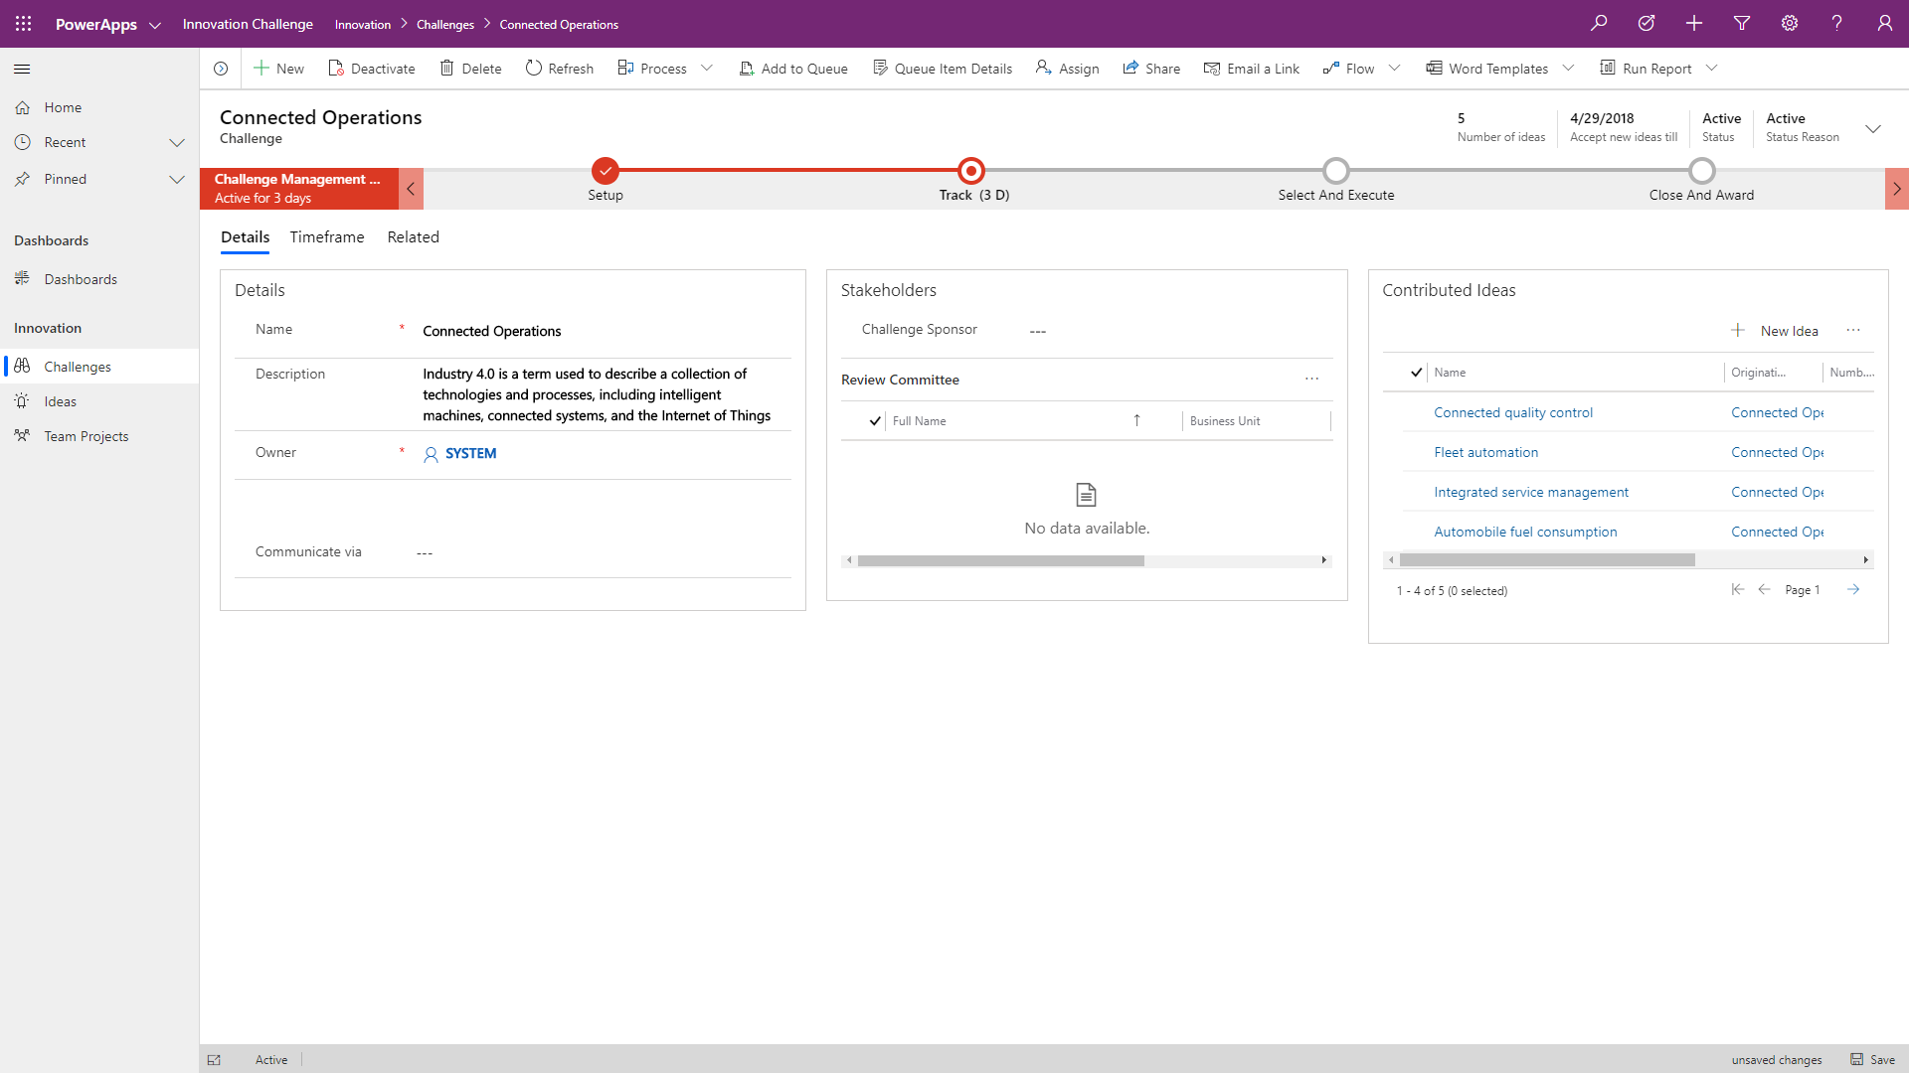
Types of Power Apps
Canvas apps start with user experience, with pixel-perfect control to build highly customized task- and role-based apps that mash up data from 300+ sources
Model-driven apps leverage your data model, relationships, and business processes to automatically generate immersive, responsive applications
Portal apps are web-based apps that allow both internal and external stakeholders to view and update Microsoft Dataverse data securely
Notes:
Today there are 3 main types of Power Apps; canvas apps, model-driven apps and portal apps. Historically, model-driven apps are an evolution of applications built on Dynamics CRM (aka xRM). Power Apps Portals evolved from Dynamics 365 Portals. Power Apps Portals can now be run on vanilla Microsoft Dataverse instances.

Slide 5
Start with model-driven
Microsoft Dataverse data driven
Backoffice / process focused
Responsive /consistent UI
User personalization
Consistent accessibility
User tooling (Excel, import, export, etc.)
Customizing existing first-party apps
Data relationship navigation
Security trimming of UI

Slide 6
Start with canvas
Not Microsoft Dataverse data driven
Task focused apps
Visual presentation of info
Custom UI
Device integration
Basic offline support
SharePoint or Teams embedding

Slide 7
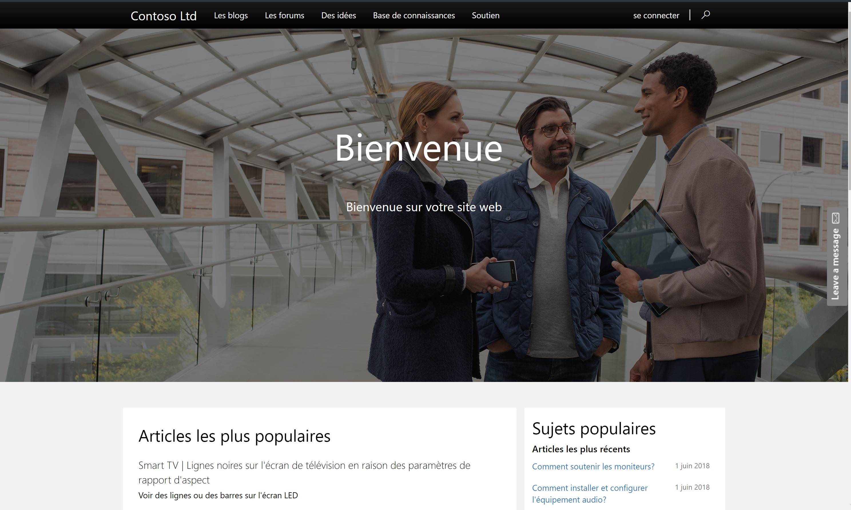
Start with portals
Microsoft Dataverse data driven
External user focused
Web application
Use Model-driven forms and views as framework to surface Microsoft Dataverse data
Can be customized with standard web technologies (HTML, JavaScript, CSS, etc.)
Notes:
Portals are a type of CMS (Content Management System) built on Microsoft Dataverse with components that can surface Microsoft Dataverse data. Portals are primarily for external facing audiences.

Slide 8
Solution architecture can have all app types
Common pattern
Administration of data using model-driven
End user canvas app
Externally facing portal
Canvas app to solve edge cases that often would be ignored
Canvas app embedded in model-driven app to introduce visuals or connectors
Notes:
Using all allows to concentrate on data/processes first and then decide the most appropriate UX for a specific set of tasks

Slide 9
App composition
Large monolithic apps should be avoided
Too many small apps are jarring to the user if they have to context switch frequently
Components can be used by multiple apps, allowing composition of apps that target users with specific needs
Offer groups of users targeted mobile apps to save time when away from their desk

Slide 10
Components as part of the app architecture
Components allow reuse within and across apps
Components can allow multiple people to work on building a single app (e.g. canvas)
Components help promote consistency and reduce redundancy
Look for visuals that would benefit from investing in making it a component (E.g. headers, common widgets etc.)
Notes:
Can hide complexity in a component

Slide 11
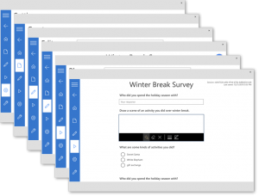
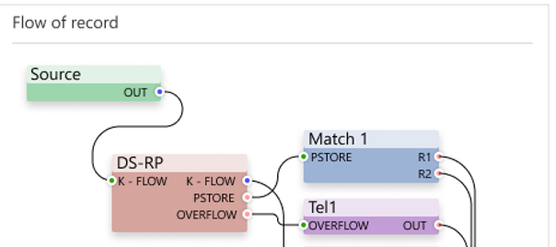
Types of components
Canvas Components
Power Apps Component Framework (PCF)
Targeted for canvas app makers
Works only in canvas apps
Targeted for professional developers to build
Works in model-driven apps today, and in preview for canvas apps

Slide 12
Canvas app components usage
Good for reuse only with in canvas apps
Can be used in multiple apps
Allows leveraging of common maker skills, makes it easier for multiple makers
Limited to capabilities of canvas app formulas and connectors
Have a strategy for managing components – building them separate from app consumers promotes best reuse and multiple makers
Updates must be re-imported in each app that consumes the component

Slide 13
PCF components usage
Can be used in both model-driven and canvas apps in both web and mobile
Can be used in multiple apps to replace columns and grids
Can be used by both new row and edit experiences
Should use purposefully to provide users a good experience
Typically can use multiple on a form without performance problems
Requires code developers with TypeScript and HTML skills
Updates are done via solution update then each app that consumes the component automatically sees the update
Notes:
Replacement for web resources

Slide 14
Embedded canvas on model-driven form
Allows form content to pull data from any of the connectors
Tied to a column on a form, but not limited to only visualizing that column’s data
Should use purposefully to provide users a good experience
Only available during edit, and not available during creating new rows
Only works in web (on mobile the columns default control is shown)
Save of form is not saving component data at same time

Slide 15
Canvas Performance Tuning Strategy
Avoid any work than you can
Defer work that is less likely to be needed
Parallelize work wherever possible
Monitor the app in operation, work may not always be obvious
Progress indicator for the end user on long running work
Notes:
App Insights and App Monitor are tools to help identify problems

Slide 16
Using test studio for repeatable testing
Support for canvas apps
Allows quick detection of regression in apps
Tests can be included as part of automated build processes
Suites
Tests
Test Steps

Slide 17
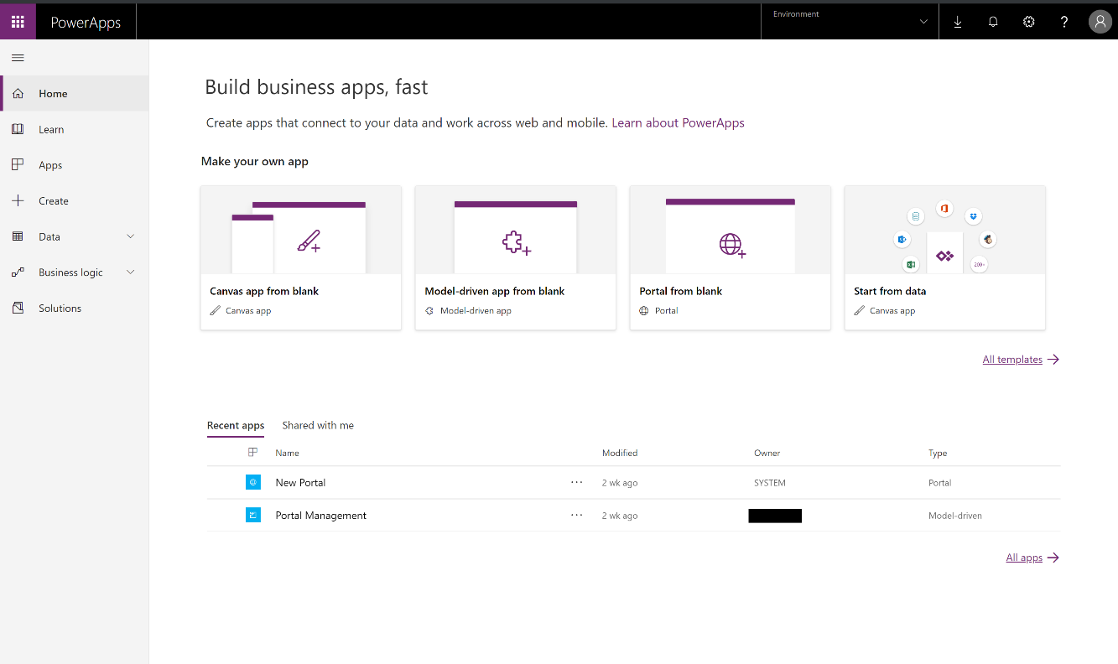
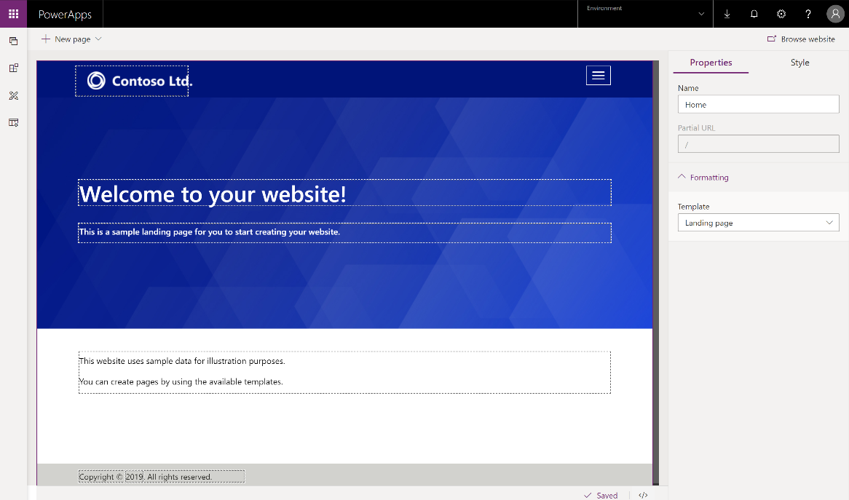
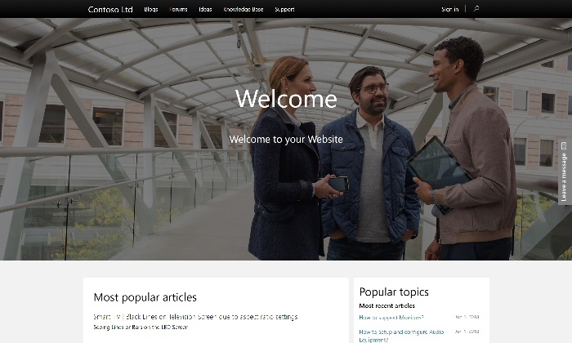
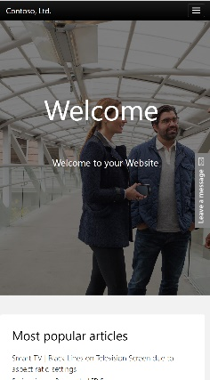
Portals

Slide 18
Power Apps portals features
Accessibility Ads Azure Integration Bootstrap Design Branding Case Deflection Case Management | Charts and Graphs Content Publisher Discussion Forums Entitlements & SLAs Table Actions Table Forms Table Lists | Entity Permissions Invitations Knowledge Management Links Location Finder Ratings and Comments Open Data Protocol | Polls Profile Management Redirects Responsive Design UX Localization Search and SEO Multi-lingual Content | Sitemap Web Design Web Forms Web Pages Web Roles Web Templating Power Automation
Business Rules
Multi-lingual
Common Data Model
Declarative Automation
Plug-in Architecture
XRM story
Centralized Management
Roles & Permissions
Portals are web enablers of Microsoft Dataverse functionality. Microsoft Dataverse differentiators are differentiators of Power Apps portals.

Slide 19
Power Apps portals – use cases
When to consider
When to exercise caution
Secure interactions with Microsoft Dataverse for external and internal users
Community or self-service sites for customer service
CRUD on Microsoft Dataverse data
Limited resources and budget, business-user and no-code configuration requirements.
Responsive design, content accessible across all devices and browsers
Multi-lingual implementations
Single sign-on
Majority of data resides in an external (non- Microsoft Dataverse / non-Dynamics 365) systems
Heavy requirements around document management, indexing and searching.
Large volumes of end-users driving heavy traffic to the Portal.
eCommerce requirements including processing payments and maintaining an online store.
Use cases that are more appropriate for direct Power Apps licensed user access
Notes:
Pros
Expose Microsoft Dataverse data in a simple, secure web interface. This may be external users (like customers and partners) or internal users whose role does not warrant full Power Apps client access.
Provide access to simple community forums, self-service knowledgebase and web forms for service requests, cases or other Microsoft Dataverse / Dynamics 365 data management.
Requirement for a website to read, update and create Microsoft Dataverse / Dynamics 365 data in an out of the box, ready to deploy manner.
Limited resources and budget for large scale web development, business-user and no-code configuration requirements.
Need for responsive design, content accessible across all resolutions, devices, and browsers.
Multi-lingual implementations where you need to serve audiences of different languages or are required to provide multi-language services by law.
Secure connection to Microsoft Dataverse , Single Sign-On.
Cons
The following may be viewed as red flags or disqualifiers for Power Apps portals
Majority of data to surface on the web resides in an external (non-Microsoft Dataverse / non-Dynamics 365) system.
Heavy requirements around document management, indexing and searching.
Large volumes of end-users driving heavy traffic to the Portal.
eCommerce requirements including processing payments and maintaining an online store.
Use cases that are more appropriate for direct Power Apps licensed user access.

Slide 20
Wrapping up
A user's app experience will be how they judge your solution architecture
Take the time upfront to properly design your app composition and identify components that should be built

Slide 21
Group exercise: Evaluate needs for apps
Evaluate needs
Suggest apps
What architecture considerations do you have?
Notes:
You are building a solution for Fabrikam to track visitors to a showroom and manufacturing site. Some of the visitors are potential purchasers and some are just there to see the magic of the robots working.

